Slide 1
MBTA Database Management System
Project by
Priyanka Kuklani (002100718)
Saad Ghojaria (002129718)
Sakshee Naik (001580738)

Slide 2
Project Scope
Developing a centralized Train Management Database System for the City of Boston, this will facilitate functionalities like Searching schedule, Booking and Cancellation of tickets with the aim of improving upon the current system by saving passenger’s time & efforts in the process.
Thousands of users use the ‘Charlie card’ everyday to access the trains, however, there is no centralized application that will help the customer to refill their cards and know their current balance without manually doing so from the kiosk.
This application facilitates this provision to update balance in their Charlie cards. Also the customer can check their Charlie card value from this application. It also aims to secure the passenger’s added value in case they happen to lose their physical cards.

Slide 3
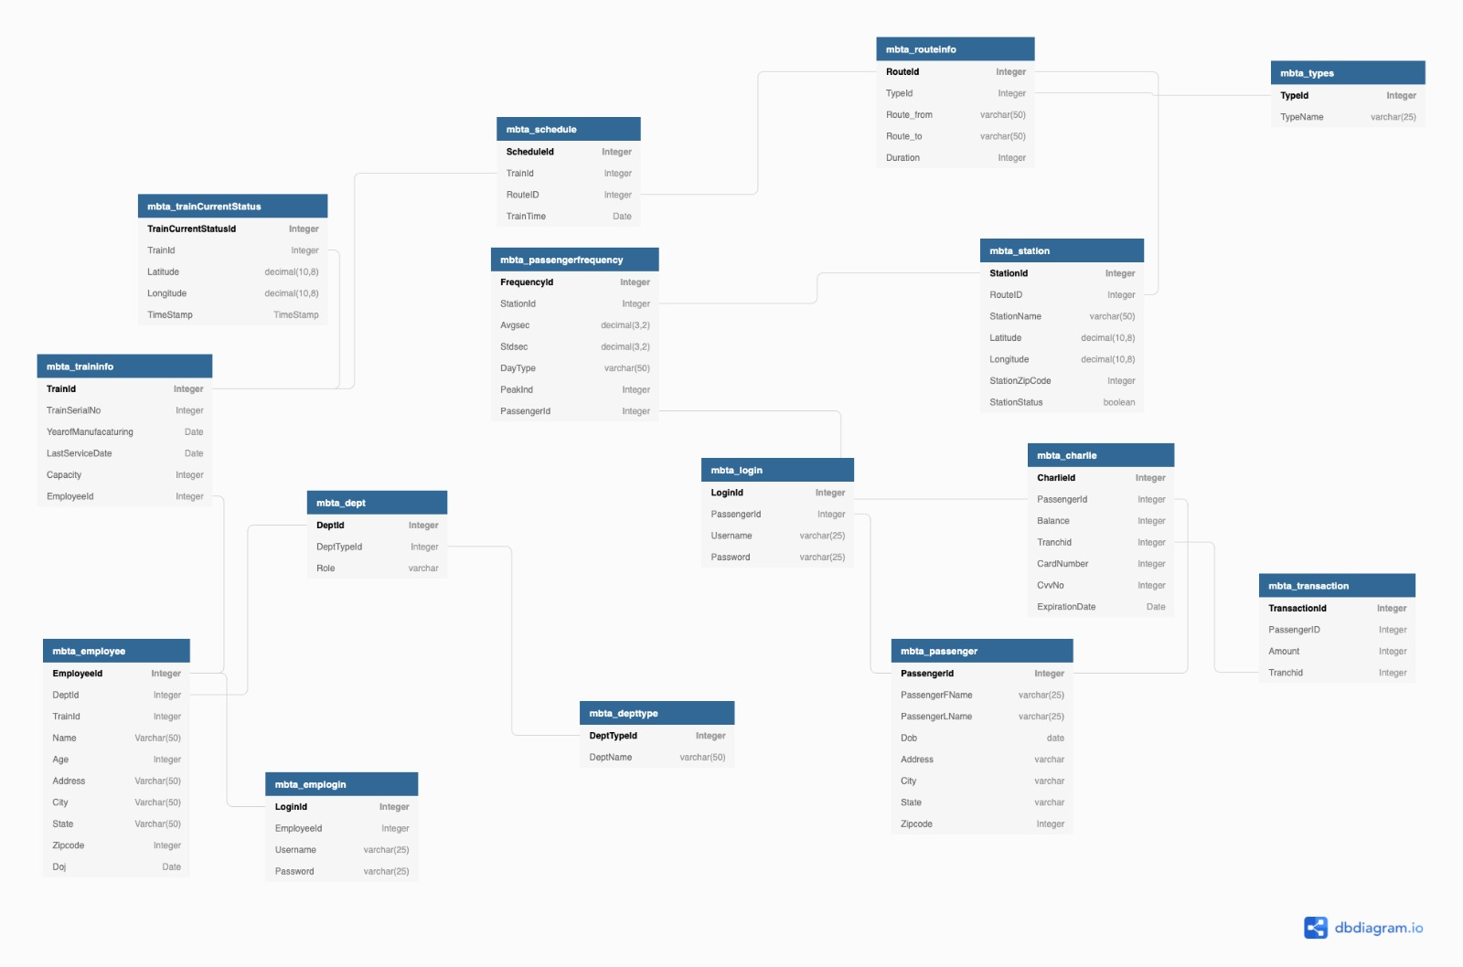
ER Diagram

Slide 4
Individual Contributions:
Priyanka Kuklani
Tables handled:
MBTA_Employee
MBTA_Emplogin
MBTA_Department
MBTA_DeptType
MBTA_Passenger
MBTA_Login
ER Diagram, DDL and DML operations related to these tables.
Procedures: MBTA_CREATEDEPT ,MBTA_CREATEDEPTTYPE, MBTA_CREATEORUPDATEPASSLOGIN, MBTA_CREATEORUPDATEPASSPROFILE, MBTA_CREATEORUPDATEEMPLOYEELOGIN, MBTA_CREATEORUPDATEEMPLOYEEPROFILE.
Functions: AUTHENTICATE_EMPLOYEE, AUTHENTICATE_PASSENGER, CHECK_PASS_ID, GET_CHARLIE_BALANCE.
Packages: PASSENGER_CHARLIE (get_balance, print_balance, add_balance, deduct_balance).
Views: MBTA_EMPLOYEEPROFILE, MBTA_PASSENGERPROFILE.
Reports SQL: REPORT TO FETCH EMPLOYEE DISTRIBUTION BY DEPARTMENTS,FETCH NUMBER OF PASSENGERS BENEFITED FROM MBTA, GET AGE DISTRIBUTION OF PASSENGERS USING MBTA, TOTAL EARNINGS BY MBTA, AGEING TRAINS NEEDING TO BE RETIRED (> 15 YRS), TRAINS NOT SERVICED IN THE LAST 6 MONTHS.
Compilation of project, DDL and DML commands.

Slide 5
Individual Contributions: Saad Ghojaria
Tables handled:
MBTA_Types
MBTA_Station
MBTA_Routeinfo
MBTA_Schedule
MBTA_PassengerFrequency
MBTA_Traincurrentstatus
MBTA_Traininfo
2. ER Diagram, DDL and DML operations related to these tables
3. Procedure: get_next_station, get_route, insert_into_mbta_station,insert_into_traincurrentstatus, insert_into_traininfo,insert_schedule,get_miles
Functions:check_next_employeeid,distance,check_dateformat,next_trainserialno,next_trainid_traininfo,check_service_manu
Triggers : Delete_employee, delete_passenger
Sequences : seq_mbta_station,mbta_traincurrentstatus
Indexes : mbta_transaction_index
Security roles

Slide 6
Individual Contributions:
Sakshee Naik
Tables handled:
MBTA_Passenger
MBTA_Login
MBTA_Charlie
MBTA_Transaction
ER Diagram, DDL and DML operations related to these tables
Documentation

